Slide 1

Denoising Autoencoder
A Machine learning Project

Slide 2
What is an Auto Encoder?
An autoencoder is a type of artificial neural network used to learn efficient encodings of unlabeled data (unsupervised learning) through the encoder. The encoding is then processed by a decoder attempting to regenerate the input from the encoding.

Slide 3
Applications of Auto Encoders:
Denoising the input data
Dimensionality Reduction
Anomaly Detection
Image Processing and Reconstruction

Slide 4
Denoising Auto Encoder
The denoising autoencoder is a type of autoencoder which removes noise from input to improve the quality of the data.
The Aim of the autoencoder is use black and white images and remove noise from them and produce clean image without noise.

Slide 5
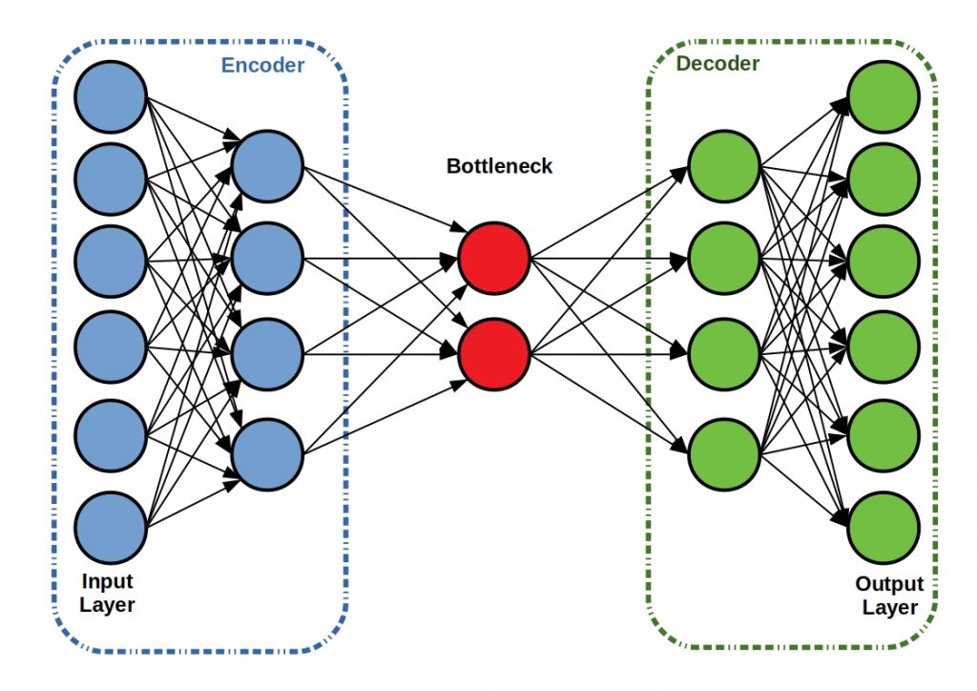
Auto Encoder Architecture

Slide 6
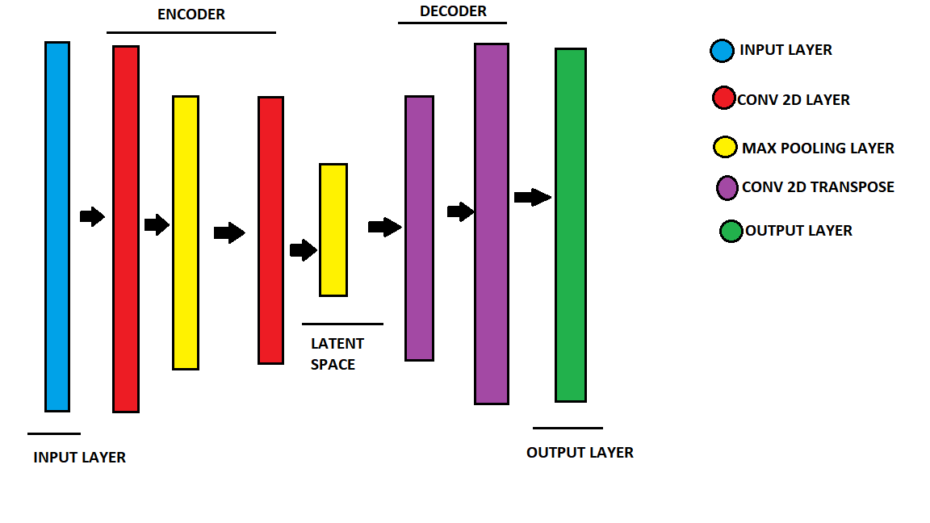
Architecture of Denoising Autoencoder

Slide 7
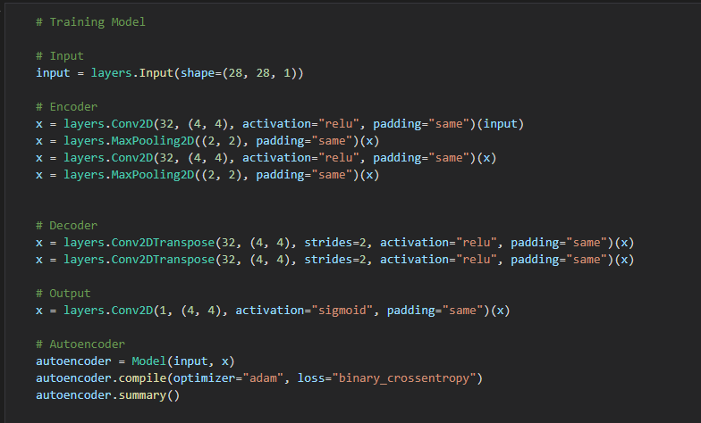
CODE

Slide 8
Model Training Details:
The Autoencoder was trained with 60000 sample images from the MNIST dataset , with batch size of 200 images and 60 epochs.
There were 60000 sample images from the FASHION MNIST dataset, with batch size of 200 images and 75 epochs.
In both cases the training set was with 60000 images and the test set was containing 10000 images.
The loss function used was binary cross entropy and optimizer used was Adam.

Slide 9
Results
On FAISHON MNIST dataset
Accuracy was 74.25%.
On MNIST dataset accuracy was around 93.12% .
On Being trained on both the Datasets the model was 74% accurate.

Slide 10
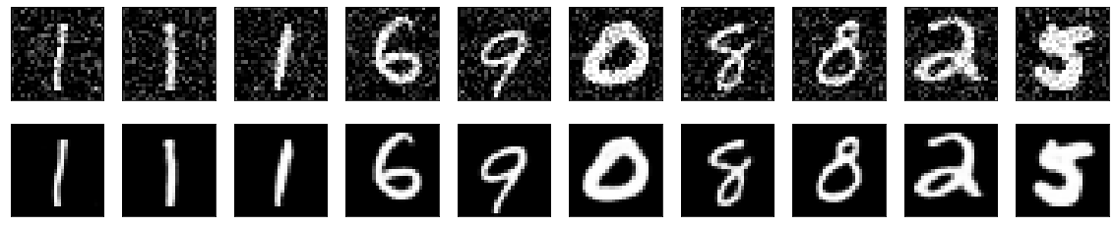
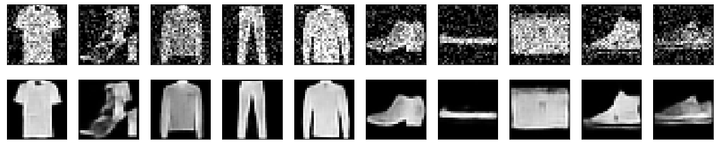
RESULTS

Slide 11
THANK YOU

